Slide 1
Case Study: interception of torrent traffic and what should we do about it
Jelena Jovanović
Notes:
The study includes analysis of actual conflict of interest when it comes to the three rights - the right to privacy of communication, the right to protection of personal data and Copyright law.
These three groups of rights are the subject of analysis in the light of current legislation of the Republic of Serbia for the conflict that exists when using electronic communications for copyright infringement.
This conflict is particularly important when analyzing the conduct of Internet operator in Serbia, which retained the personal data about users and give them away in response to alleged copyright infringement. The presentation focuses on the treatment of ISPs, users and copyright holders, putting the emphasis on the shortcomings of the existing system of protection that inevitably manifests violation of the right to privacy of communication, and the right to protection of personal data. But what is really going on? Direct cause for this analysis is the behavior of Internet providers in the Republic of Serbia, who regularly send "warning letters" in which they state that "it was noticed that downloading certain files on the Internet is copyright infringement". To make threatening letter more obscure, as a source of information about the "unauthorized downloading" in their warning letters ISPs state that it is either agency, or law office representing collective copyright holders. Users are reminded to immediately delete the downloaded file from your computer (!).
Perhaps this treatment laity seems quite reasonable - someone who violates the law should be warned that his behaviour was noted, and will be appropriately sanctioned if they continue. But who here actually violate the laws of the Republic of Serbia: users, operators, copyright holders, or all together?
Presentation will show both legal and technical aspects of analysis. In Serbia file-sharers have been monitored closely by DRM agencies, and ISPs are prone to cooperate with them regardless of laws that regulate their fundamental obligations to Internet users. Also, this presentation will show which results we, concerned citizens, activists, tech people and lawyers, got when we presented our findings to higher (govt) instances. Some may call it whistleblowing, because it's clear pointing out to wrongdoings against us, interwebz. After the threats we received, and useless attempts to stop us talking about what's fair and what's nor, and especially after fines that ISPs in Serbia now have to pay because of lack of basic law abiding behaviour, the good assumption is that broader audience on BalCCon 2014 is ready to hear what is happening behind the back of internet users.
Keywords
Right to privacy of electronic communications, personal data protection, copyright, internet operators, torrent traffic, interception.

Slide 2
Right to share and seek culture and knowledge
“Everyone has the right to freedom of expression. This right shall include freedom to hold opinions and to receive and impart information and ideas without interference by public authority and regardless of frontiers.”
(European Convention of Human Rights, article 10)
Notes:
Banning file sharing is violation of human rights!
The European Court of Human Rights has declared that the copyright monopoly stands in direct conflict with fundamental Human Rights, as defined in the European Union and elsewhere.
This means that as of last year (2013) nobody for sharing culture in the EU may be convicted just for breaking the copyright monopoly law; the bar for convicting was raised considerably. This can be expected to have far-reaching implications, not just judicially, but in confirming that the copyright monopoly stands at odds with human rights.

Slide 3
File-sharing is state of mind!
Filesharing is not a side-effect of internet
It changed the way we communicate
NOT a crime!
Notes:
People are conducting more and more of their daily business online and through their mobile devices. They use the Internet and their smartphones and tablets to make purchases, research medical conditions, plan vacations, interact with friends and relatives, do their jobs, map travel routes, and otherwise pursue their interests. With these activities, uisers are creating a voluminous and unprecedented trail of data regarding who they are, where they live, and what they own.
These changes have fueled the growth of a multi-billion dollar industry that largely operates hidden from people’s view. Today, a wide range of companies collect and maintain data on hundreds of millions of consumers, which they analyze, package, and sell generally without consumer permission or input.
Yet, laws define file -sharing legal (to some extent) - for private use, and if purpose is not to gain a profit.

Slide 4
Copyright regime
Notes:
Users generally have no means of knowing the extent and nature of information that corporations, law offices, and DMCA agencies, collect about them and share with others for their own financial gain.
Dozens of adult companies are using "copyright trolling" tactics to supplement their income.
In Serbia file-sharers have been monitored closely by DRM agencies, and ISPs (which are often cell phone careers as well). shows that they are prone to cooperate with them regardless of laws that regulate their fundamental obligations to Internet users.
And how do they do it?

Slide 5
5 scenarios of obtaining user’s data
Notes:
We have identified five ways to get to information about users.
1 Seizure data in another country
ie: FBI confiscate all the data from megaupload. Or perhaps send a rapidshare account-in to submit a list of users who have DLed some copyright content. Your IP remained in the logs reached by copyright owners, confiscation of servers and other similar actions. So this info and just simply forward your ISP.
This scenario is described as a "server seizure by the FBI": a public authority of the country will legally under the law of that country to the specific information indicating a violation of copyright law, and put them copyright holders. Copyright holders are thus legally entered the data from which can make it probable that violate copyrights.
They, howevevr, can not "give order" ISP's to identify the user, they can only go to court, according to the cited articles of the Law on Copyright and Related Rights Act, or forward them to the public prosecutor's office in order to perform an investigation of potential committed criminal offenses.
If a foreign government body transmit data through the channels of interstate cooperation in criminal matters - they can turn to Serbian prosecution for cybercrime (which happens quite often), the prosecutor will assess whether there are elements of the offense, and seek a court order -

Slide 6
1. server seizure by the FBI
Notes:
We have identified five ways to get to information about users.
1 Seizure data in another country
ie: FBI confiscate all the data from megaupload. Or perhaps send a rapidshare account-in to submit a list of users who have DLed some copyright content. Your IP remained in the logs reached by copyright owners, confiscation of servers and other similar actions. So this info and just simply forward your ISP.
This scenario is described as a "server seizure by the FBI": a public authority of the country will legally under the law of that country to the specific information indicating a violation of copyright law, and put them copyright holders. Copyright holders are thus legally entered the data from which can make it probable that violate copyrights.
They, howevevr, can not "give order" ISP's to identify the user, they can only go to court, according to the cited articles of the Law on Copyright and Related Rights Act, or forward them to the public prosecutor's office in order to perform an investigation of potential committed criminal offenses.
If a foreign government body transmit data through the channels of interstate cooperation in criminal matters - they can turn to Serbian prosecution for cybercrime (which happens quite often), the prosecutor will assess whether there are elements of the offense, and seek a court order -

Slide 7
2. DMCA or LAW Agency sets up own torrent server and monitors who downloads content
Notes:
Although this imaginative and practically applicable, and as we have been informed relatively common way to collect information about users, this scenario has one major flaw - it boils down to the Law on copyright - its ONLY the author or copyright holder that has the right to publish the work - the right to determine WAYS OF SHARING.
The author has the exclusive right to authorize or prohibit the recording and reproduction of his work, in whole or in part, by any means, in any form, by any permanent or temporary, direct or indirect way.
If the author decides that he wants to share his work with the internet community for free (putting torrent with that part of it comes down to the manner of its publication or copying) of Internet users who do not violate any regulation.
Therefore, it is needless to say that any subsequent action of the copyright holder in preventing such activities, or disclosure of the identity of the user using the "generosity" of the author, to be illegal. Otherwise, putting a content on torrents despite of author’s will is crime itself. And a

Slide 8
3. They track our IP adresses
Notes:
Probably the simplest scenario, but still illegal.
user's IP address is personal information and as such is protected by a special legal regime, and may not be used for anything other than for the purposes which are not pre-agreed.
IP adress is private. Not because it can fully identify the user but because it can point out to his identification. Like physicall location or parts of your identity obtained by government- social security number
Logical fallacy lies in assumption that
if torrent files are publicly available on the Internet, any user has given consent to make his / her IP address public, and that anyone can do with it whatever he wants.
Its handy explanation, but if its not law abiding!!
The user has given consent to its IP address is only used for file sharing, but not to be recorded, forwarded to third parties and used by the holder of copyright for any other purpose.
Therefore, anyone who records user IP address and forwards them to the holders of copyrights violation of the privacy of user data, because the user has not given consent to its ip address used for this purpose.

Slide 9
4. Providers on behalf of copyright holders perform continuous interception of user data
Notes:
Same as tracking!
This has already been explained in previous published text as completely illegal behavior that constituted a number of criminal acts by the ISP Jeva, and copyright holders. Violation of Terms of Service, user’s privacy,
and last, but not the least, what torrent companies can gain?
SOME THINGS CANT BE UNBROKEN.
The only stake holder that matters on the Internet is the people who use it.
Other ways - new letter asking for movie on smartphone DLed 12 months before. Deep packet inspection or what? You tell me.

Slide 10
5. The execution of court decisions
Notes:
5 The execution of court decisions
This is the only fully legal way to get the information about users. The Court, on the basis of its authority and discretionary assessment, requires the collection of evidence in criminal and civil proceedings. However, to obtain a court decision at the request of the copyright holder, the previously (or within 30 days of the issuance of the order) must file a lawsuit and sue the user for copyright infringement (Articles 211 and 212 of the Law on Copyright and related Rights).
. Izvršenjem odluke suda
Ovo je jedini potpuno legalan način da se dođe do podataka o korisnicima. Sud, na osnovu svojih ovlašćenja i diskrecione procene, nalaže prikupljanje dokaza u krivičnom ali i parničnom postupku. Međutim, da bi se dobila odluka suda na zahtev nosioca autorskog prava, ovaj prethodno (ili najkasnije u roku od 30 dana od izdavanja naloga) mora pokrenuti parnicu, odnosno tužiti korisnika zbog kršenja autorskih prava (članovi 211. i 212. Zakona o autorskom i srodnim pravima).

Slide 11
Notes:
The case sparked aninvestigation into how ISPs are handling our private data!!!
The Commissioner for Information of Public Importance and Personal Data Protection plans on monitoring the implementation of the provisions of the Law on Personal Data Protection among electronic communications operators, especially the mobile telephony operators and internet providers.
http://www.poverenik.rs/en/activities/1550-uskoro-nadzor-nad-operatorima.html

Slide 12
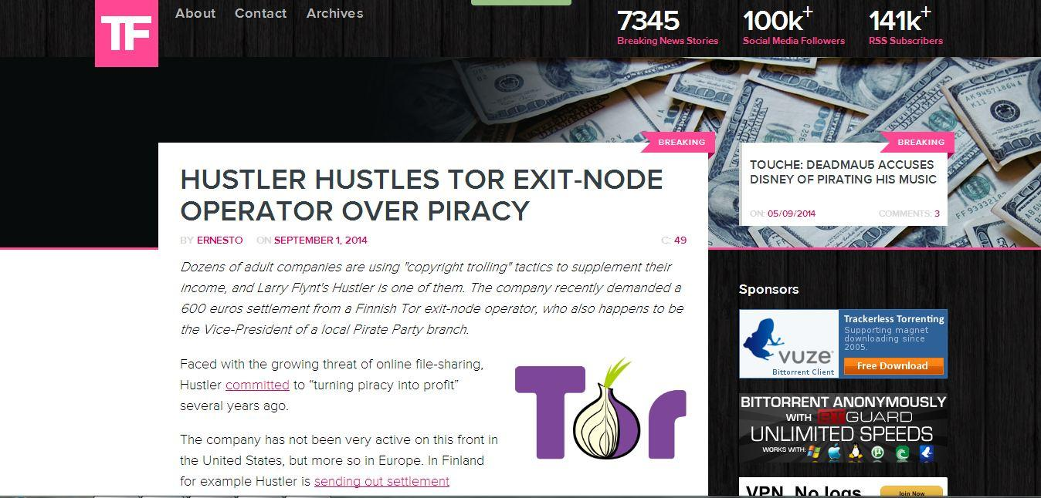
Notes:
The company recently demanded a 600 euros settlement from a Finnish Tor exit-node operator, who also happens to be the Vice-President of a local Pirate Party branch.
Faced with the growing threat of online file-sharing, Hustler committed to “turning piracy into profit” several years ago.
The company has not been very active on this front in the United States, but more so in Europe. In Finland for example Hustler is sending out settlement demands for hundreds of euros to alleged pirates.
A few days ago one of these letters arrived at the doorstep of Sebastian Mäki, identifying the IP-address through which he offers a Tor exit-node. The letter is sent by lawfirm Hedman Partners who urge Mäki to pay 600 euros ($800) in damages or face worse.
However, Mäki has no intention to pay up. Besides running a Tor exit-node and an open wireless network through the connection, he also happens to be Vice-President of a local Pirate Party branch. As such, he has a decent knowledge of how to counter these threats.
link: http://semantics.sebastianmaki.fi/2014/08/an-open-letter-is-copyright-trolling.html

Slide 13
Say no to copyright trolling!
Notes:
link: http://semantics.sebastianmaki.fi/2014/08/an-open-letter-is-copyright-trolling.html

